Slide 1
UNIT 1
Introduction to Analog Electronics
Session-2
Characteristics of JFET (Common Source, Common Drain and Common Gate configurations) and uses
Differences between BJT and JFET

Slide 2
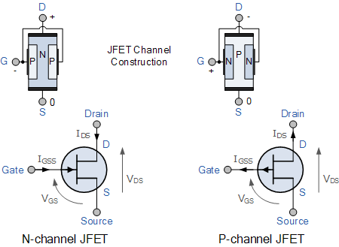
JUNCTION FIELD EFFECT TRANSISTOR (JFET)
BASICS
There are two types of JFET’s: n-channel and p-channel.
The n-channel is widely used.
Three terminals:
Drain (D) and Source (S) are connected to n-channel
Gate (G) is connected to the p-type material.
Gate is always reverse biased
Gate current, I_{G}=0
CONSTRUCTION, TYPES & SYMBOLS
(Image source: www.electronics-tutorials.ws)

Slide 3
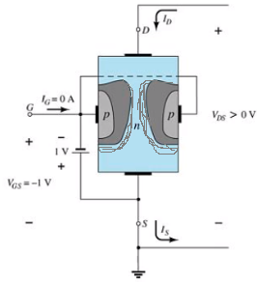
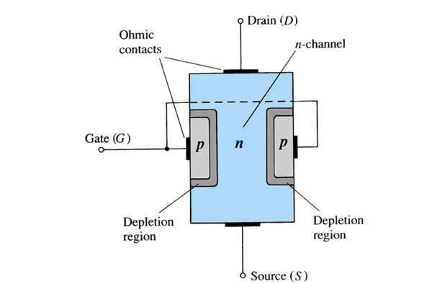
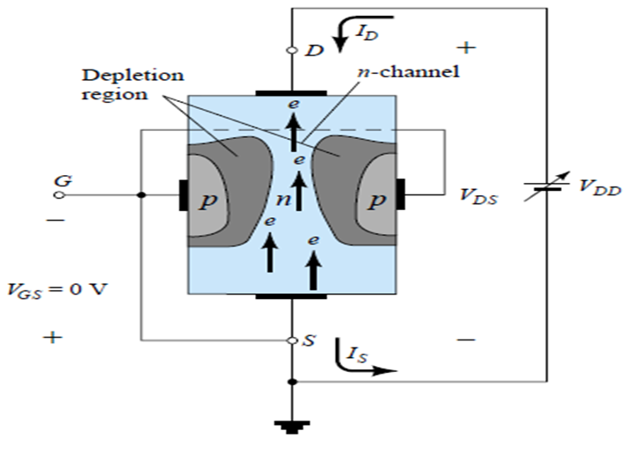
JFET (CS) WORKING
BASICS
The depletion region becomes thicker with increased reverse bias
When V_{GS} =0
When V_{GS} <0
(Adapted from: Electronic devices and Circuit theory, Robert L Boylestad and Louis Nashelsky)

Slide 4
Application
The junction field effect transistor (JFET) is used as a constant current source.
The JFET is used as a buffer amplifier.
The JFET is used as an electronic switch.
The JFET is used as a phase shift oscillator.
The JFET is used as high impedance wide band amplifier.
The JFET is used as a voltage variable resistor (VVR) or voltage development resistor (VDR).
The JFET is used as a chopper

Slide 5
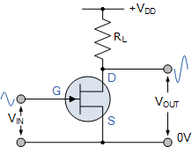
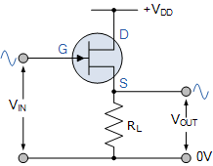
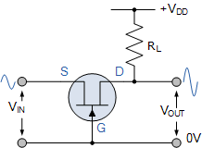
JFET AMPLIFIER-CONFIGURATIONS
BASICS
Common Source (CS) configuration (Good voltage amplifier)
Mostly used, Similar to CE transistor
Generally used in audio frequency amplifiers and in high input impedance pre-amplifier stages.
Common Drain (CD) configuration (Good voltage buffer)
Source follower
High input impedance and a low output impedance
Approx. unity voltage gain-used in buffer amplifiers.
referred to as “Common Drain” because there is no signal available at the drain connection.
Common Gate (CG) configuration (Good current buffer)
Has a low input impedance, but a high output impedance.
Applied in high frequency circuits or in impedance matching circuits where a low input impedance needs to be matched to a high output impedance
Microphone amplifiers
1
2
3

Slide 6
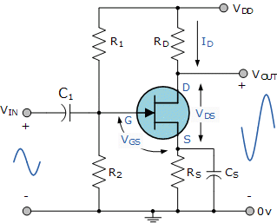
COMMON SOURCE AMPLIFIER
BASICS
In CS configuration, the input is given to the gate and the output is taken from the drain.
180 degree phase shift between input and output.
Features
Large voltage gain
Good voltage amplifier
Better transconductance amplifier
High input resistance
Medium / high output resistance

Slide 7
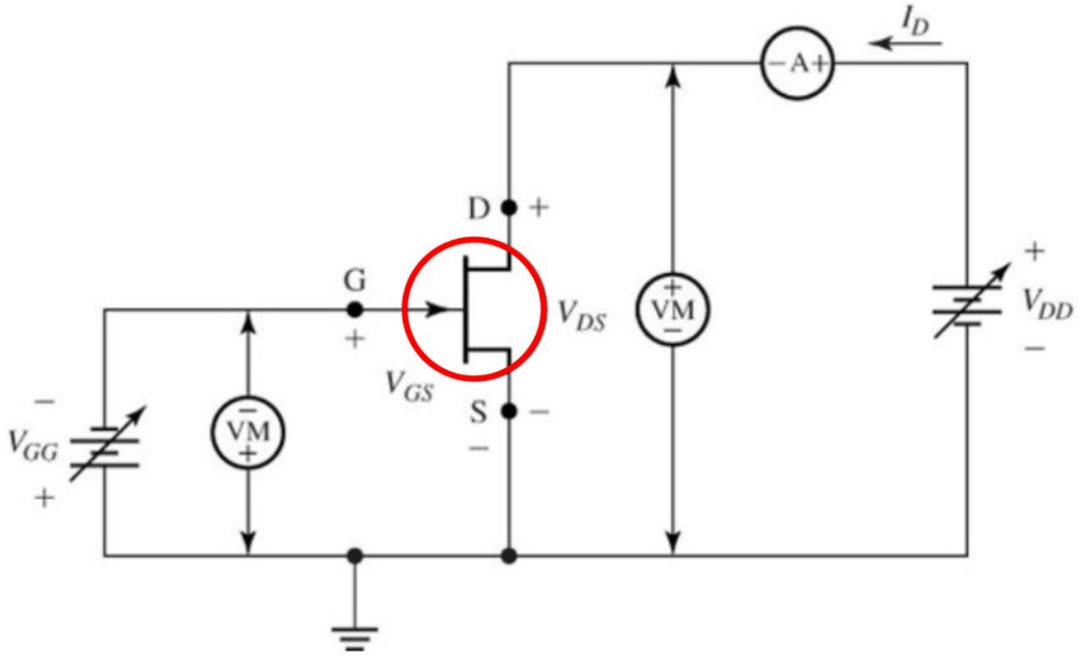
CONNECTION DIAGRAM FOR DETERMINING THE CS AMPLFIER CHARACTERISTICS
Drain Characteristics
Transfer characteristics

Slide 8
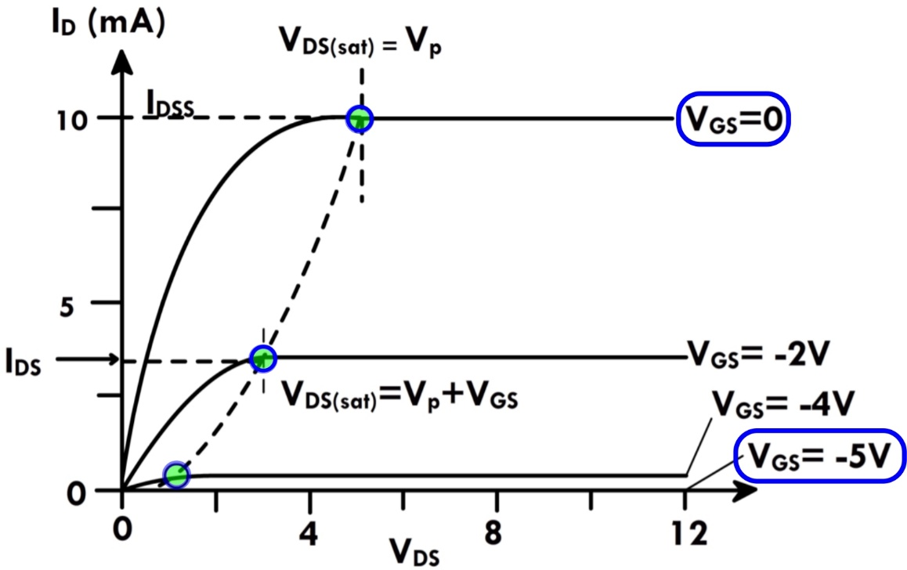
CS AMPLIFIER CHARACTERISTICS
Drain or V-I characteristics
Output characteristics
Relationship between Drain current (I_{D}) and Drain to source voltage (V_{DS}) for different values of gate to source voltage (V_{GS})
Operation analysis includes
Without external bias: (V_{GS} =0)
With external bias.
I_{D} VS V_{DS} FOR V_{GS} = constant
V_{GS} Depletion layer I_{D}.

Slide 9
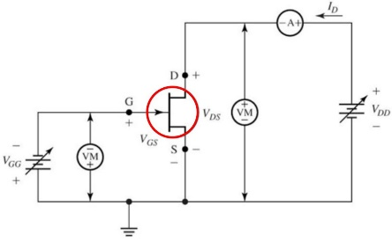
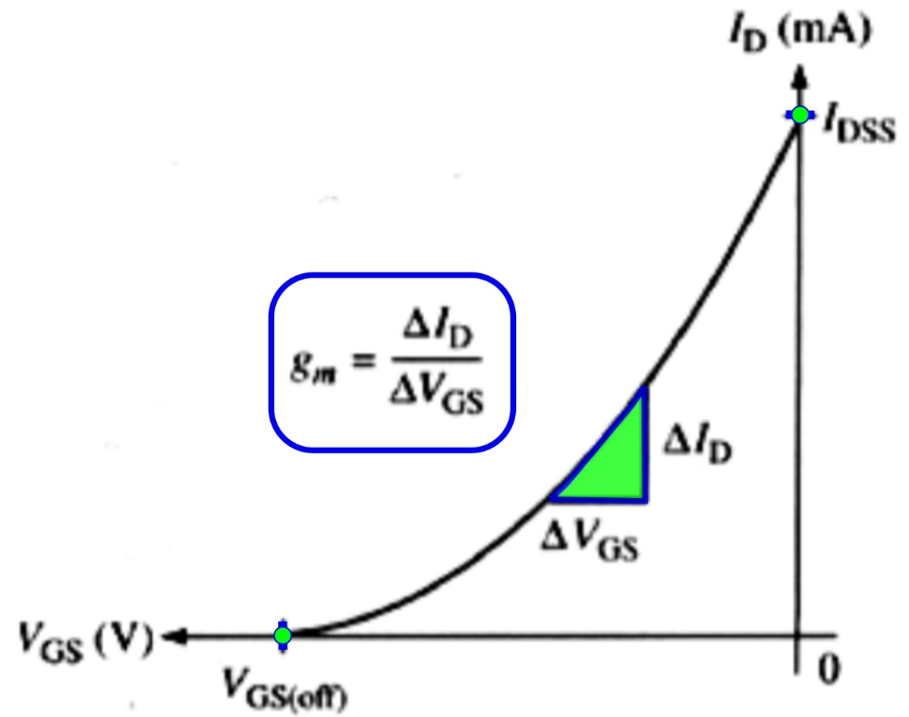

CS AMPLIFIER CHARACTERISTICS
The transfer characteristics
The plot of the drain current Vs gate-source voltage for different values of drain to source voltage (V_{GS})
It is observed that the value of drain current varies inversely with respect to gate-source voltage when the drain-source voltage is constant.
The transfer characteristics is drawn between
input voltage and output current.
I_{D} VS. V_{GS} FOR V_{DS} = constant

Slide 10
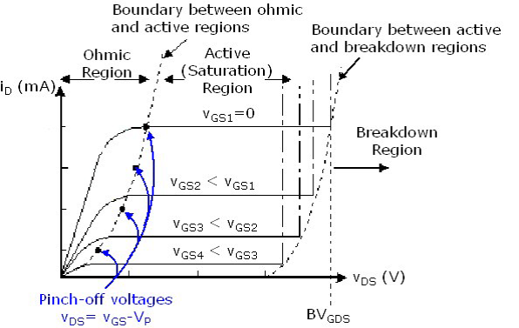
CS AMPLIFIER CHARACTERISTICS
At the pinch-off point,
V_{GS} at pinch-off is denoted as V_{p}
any further increase in V_{DS} does not produce any increase in I_{D}
I_{D} is at saturation or maximum. It is referred to as I_{DSS}.
(Image source: www.rezzonics.blogspot.com)

Slide 11
CS AMPLIFIER CHARACTERISTICS
Important terms in JFET drain characteristics
Knee Point: Where the variation of drain current with drain-source voltage appears to be linear. But beyond this point, the linearity changes into a curve.
Channel Ohmic Region: The region to the left of the knee point in the characteristics curve.
Pinch-off point: The point in the curve beyond which the drain current will not increase further no matter how much we are increasing the drain to source voltage.
Pinch-off Voltage: The voltage at the pinch-off point is termed as pinch-off voltage because at this voltage, the current is completely turned to be constant.
Drain-Source Saturation Current: The drain to source saturation current is the current which becomes constant and enters into a saturation state.

Slide 12
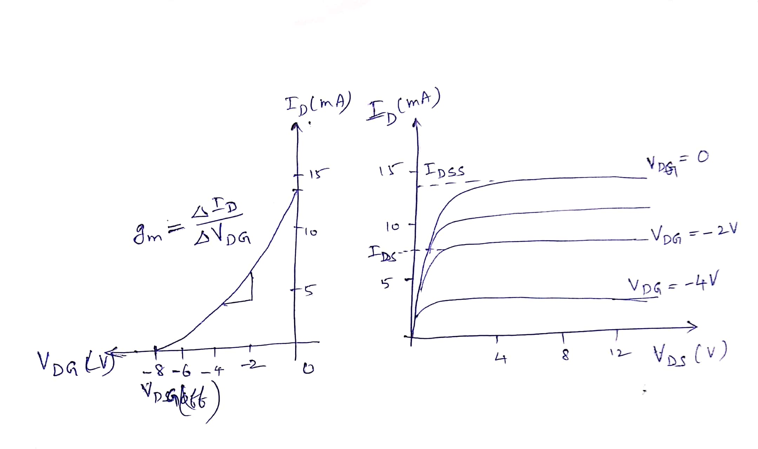
COMMON DRAIN JFET AMPLIFIER (Source follower)
The output characteristics
Connect voltmeters and ammeters to measure the necessary voltages and currents (as explained in CS amplifier connections)
The transfer characteristics

Slide 13
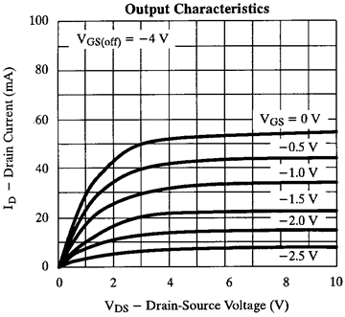
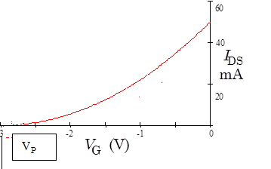
COMMON GATE JFET AMPLIFIER-CHARACTERISTICS
The output characteristics
Connect voltmeters and ammeters to measure the necessary voltages and currents (as explained in CS amplifier connections)
The transfer characteristics

Slide 14
COMPARISON BETWEEN BJT AND JFET
BJT | JFET
Bipolar device (current condition, by both types of carriers, i.e. majority and minority-electrons and hole). | Unipolar device (current conduction is only due to one type of majority carrier either electron or hole).
The operation depends on the injection of minority carries across a forward biased junction. | The operation depends on the control of a junction depletion width under reverse bias.
Current controlled device. The base current controls the output current. | Voltage controlled device. The gate voltage controls output current.
High noise level. (current conduction through junctions) | Low noise level. ( current conduction is through n-channel or p-channel and no junction crossing)
Low input impedance (due to forward bias at input side). | High input impedance (due to reverse bias).
Gain is characterized by voltage gain. | Gain is characterised by transconductance.
Low thermal stability. (positive temperature coefficient at high current levels lead to thermal breakdown) | Better thermal stability.(NTC at high current levels prevent thermal breakdown)
Cheaper | Relatively costly

Slide 15
REVIEW QUESTIONS
Source follower is a circuit that provides_________
In CS amplifier, the drain-source current is largest when the gate-source voltage V_{GS} is____
Which JFET amplifier configuration is used in microphone amplifiers?
JFET is a ___ controlled device

Slide 16
UNIT 1
Introduction to Analog Electronics
Session-3
NEXT
Transistor Amplifier: CE amplifier
Transistor Amplifier: CC ,CB amplifier

